Slide 1
AI-Based Student Dropout Prediction & Counseling System
IIMT COLLEGE OF ENGINEERING
Knowledge Park III , Greater Noida
(Department of Computer Science and Engineering-AI)

Slide 2
CONTENTS
Introduction
Objectives
Planning of work
Methodology
Snapshots of Work
Future scope of the Project
References

Slide 3
INTRODUCTION
The idea of the project is to predict the dropout risk of students using academic, personal, and behavioral factors and provide proper counseling recommendations to reduce their dropout possibility. The system analyzes student performance data and predicts whether the student is at low, medium, or high risk and then provides personalized guidance or counseling suggestions.

Slide 4
OBJECTIVES
• Predict student dropout risk using academic and behavioral data.
• Categorize students as Low, Medium, or High risk.
• Provide personalized counseling recommendations.
• Help institutions reduce dropout rates.

Slide 5
Planning of work
Step 1
Step 2
Step 3
Step 4
Step 5
Problem Identification
Data Collection & Feature Identification
Data Normalization
Risk Prediction Model
Counselling Suggestion Generation and System Implementation

Slide 6
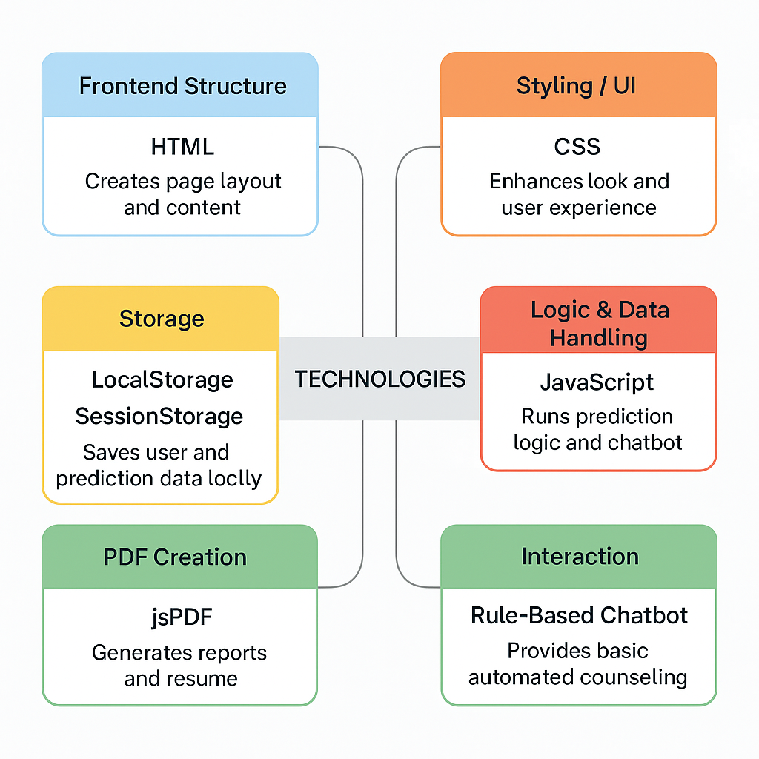
METHODOLOGY
Start
↓
Identify Dropout Factors
↓
Collect & Preprocess Student Data
↓
Normalize Feature Values
↓
Apply Logistic Risk Prediction Model
↓
Classify Risk (Low / Medium / High)
↓
Provide Counseling Suggestions

Slide 7
System Features
• Dropout Risk Prediction Module
• Personalized Counseling Suggestions
• Chat bot for quick student support
• Daily Routine Tracker
• To-Do Task Manager
• Resume Builder

Slide 8
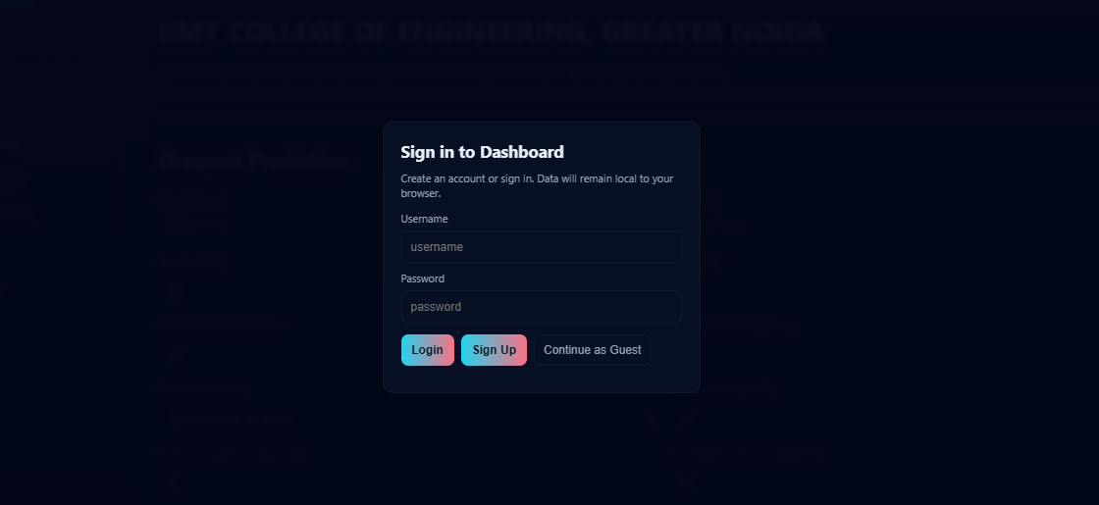
Snapshot of Login Page

Slide 9
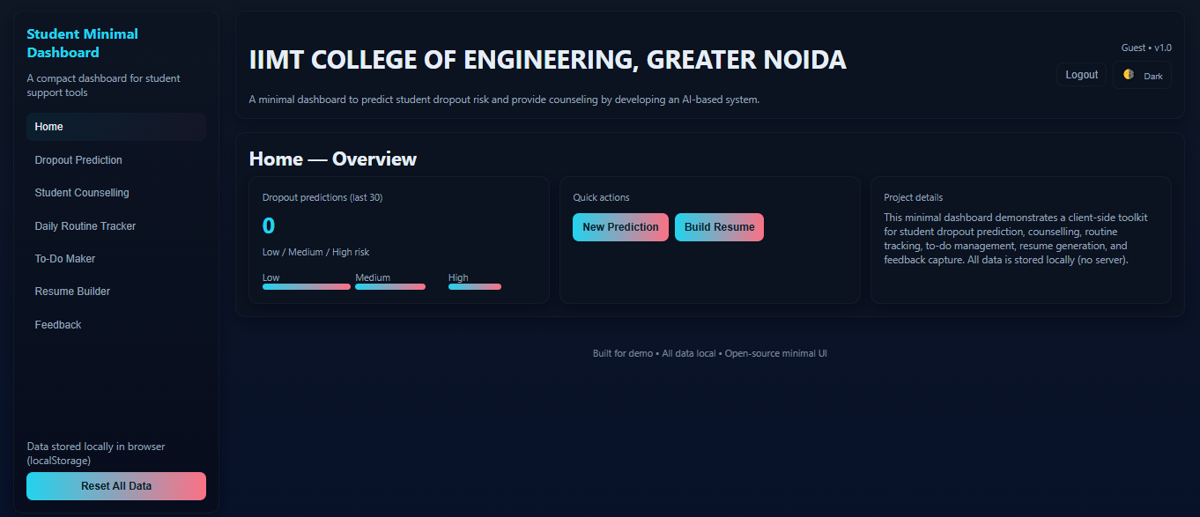

Slide 10
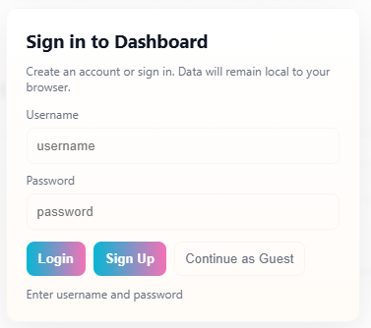
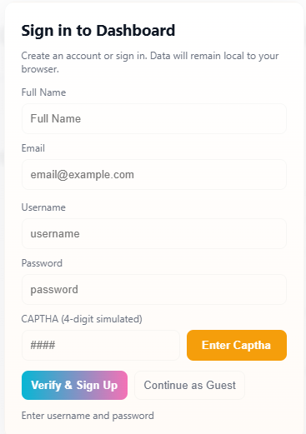
Snapshot of work
Login Page
Signup Page

Slide 11
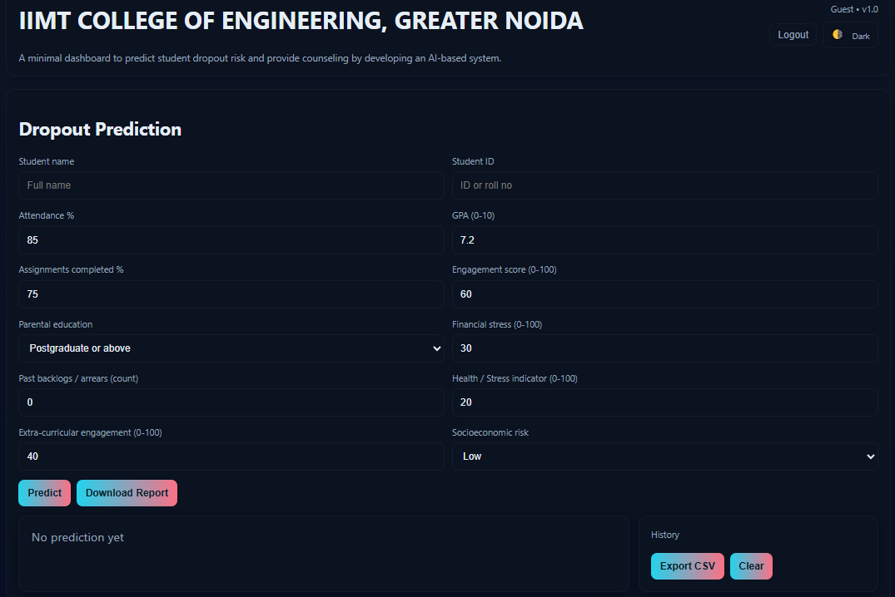
Prediction system

Slide 12
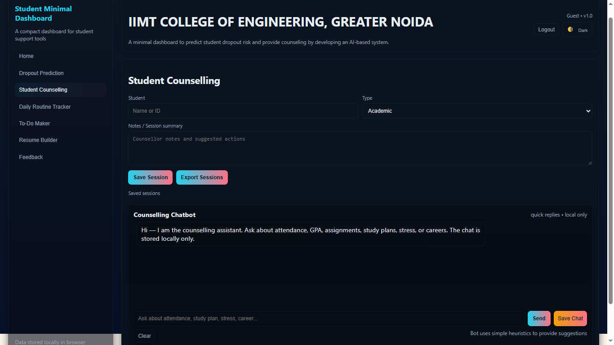
Counseling system

Slide 13
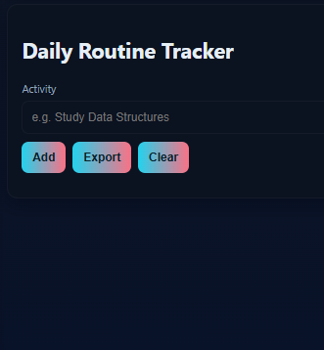
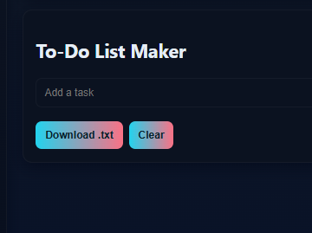
Daily Routine Tracker To-Do List Maker

Slide 14
FUTURE SCOPE
• Integrate real-time college database.
• Use advanced ML models for improved accuracy.
• Expand counseling to mental health and career planning.
• Develop mobile app version.

Slide 15
References
www.stackoverflow.com
www.wikipedia.com
https://www.geeksforgeeks.org/
https://www.javatpoint.com/
https://www.w3schools.com/
•www.youtube.com

Slide 16
THANK YOU

